Slide 1
Speed Detection Using YOLOV4
A presentation by AIE A’s 10 batch
th

Slide 2
Meet Our Team
01
02
03
04
Bhavesh Reddy
Harini
CB.SC.U4AIE24034
CB.SC.U4AIE24010
Pratheep Reddy
Yogeswar Reddy
CB.SC.U4AIE24021
CB.SC.U4AIE24011

Slide 3
INTRODUCTION
Vehicle speed detection is crucial for traffic management, law enforcement, and road safety.
With advancements in deep learning and computer vision, AI-based solutions offer a cost-effective and scalable approach to speed detection.

Slide 4
PROBLEM STATEMENT:
Over speeding of vehicles is leading to accidents.
Traditional speed detection methods like radar guns are more handy than camera detection but high cost.
Need for a Cost-Effective and Automated Solution
Challenges in Real-Time Vehicle Detection and Tracking.
Difficulty in License Plate and Manufacturer Identification.

Slide 5
S.NO | PAPER NAME | METHODOLOGY | CONTRIBUTION | YEAR
1 | Moving vehicle speed and distance estimation in autonomous vehicles | Vehicle Detection: SSD,YOLOv4. Tracking Vehicles: DeepSORT. Speed Calculation: Relative velocity from the displacement of the vehicle over time. | This paper enhances speed and distance estimation in autonomous vehicles for safer navigation. It improves collision avoidance using sensor fusion. | 2023
2 | Vision-based vehicle speed estimation using YOLO Detector and RNN | Vehicle Detection and Tracking: YOLO Algorithm. Speed Calculation: RNN(Recurrent Neural Network). | This paper improves vision-based speed estimation using YOLO and RNN for accurate vehicle tracking. It enhances traffic monitoring and road safety. | 2023
3 | Deep Learning based Vehicle Speed Estimation Using YOLO detector and 1D-CNN | Feature Extraction: CBBA Speed Estimation: CBBA features in fed into a 1D-CNN. Evaluation: RMSE(Root mean square Error) | This paper enhances vehicle speed estimation using YOLO and 1D-CNN for accurate real-time tracking. It improves traffic safety and surveillance. | 2023

Slide 6
Outcomes
70.0%
15 FPS
Accuracy
Speed
YOLOv4 achieves real time performance with inference speeds exceeding 15 frames per second
YOLOv4 demonstrates high accuracy in real world scenarios

Slide 7
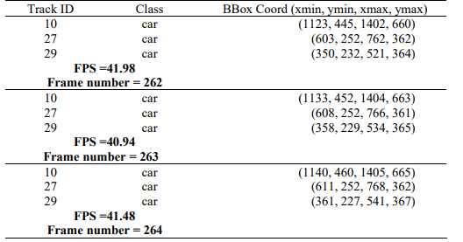
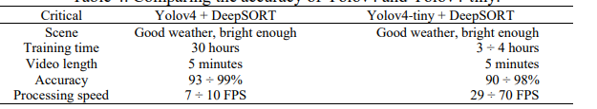

YOLOv4 vs YOLOv4-tiny

Slide 8
01
ADVANTAGES

Slide 9
Improve Traffic Management
Helps monitor vehicle speed to reduce accidents.
Assists in enforcing speed limits and detecting violations.
Enhances traffic flow analysis for better city planning.
Enhance Road Safety
Detects speeding vehicles and potential collisions in real time.
Identifies pedestrians and other obstacles to prevent accidents.
Supports autonomous vehicle navigation and decision-making.
Efficient Law Enforcement
Enables automatic number plate recognition(ANPR) with object and color detection.
Provides evidence for traffic law violation.
Helps in identifying stolen or wanted vehicles based on color and model.

Slide 10
Versatility and Scalability
Can be integrated into various smart cities and surveillance.
Adaptable for multiple use cases, including tollbooths, parking management, and security system.
Works with different sensors like camera, LiDAR, and radar for better accuracy.
Cost-Effective and Automated
Reduces the need for manual monitoring and intervention.
Lowers operational costs compared to traditional speed detection methods.
Ai-driven detection minimizes human error and improves efficiency.

Slide 11
02
LIMITATIONS

Slide 12
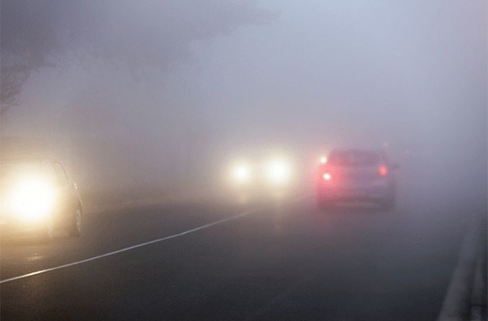
Lighting and Weather
Poor visibility from low light, glare, rain, or fog effects detection accuracy
Camera Calibration
Errors in mapping pixel distaces to real-world distances due to improper calibration
Vehicle Occlusion
Overlapping or Obscured vehicles in dense traffic make tracking difficult

Slide 13
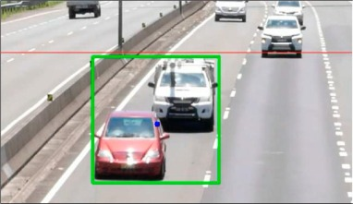
Real-Time Processing
High computational demands for real-time video processing and scalability
Scenario Diversity
Difficult detecting vehicles of different sizes or handling non standard road layouts
Privacy Concerns
Ethical issues and legal compliance related to video-based surveillance

Slide 14
FUTURE IMPLICATION
03

Slide 15
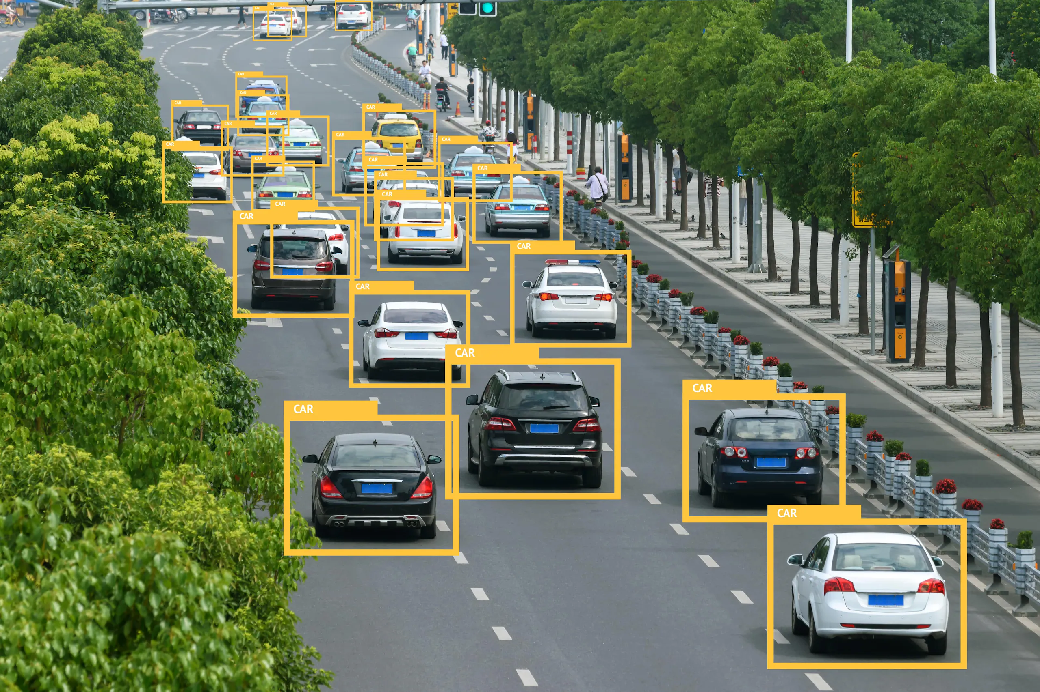
VEHICLE DETECTION AND TRACKING
YOLOv4 Efficiency
High Detection Precision
YOLOv4 provides real-time object detection with a balance of speed and accuracy, ideal for dynamic traffic conditions.
Its robustness enables accurate detection of vehicles in varying environmental and lighting conditions.
Real-Time Inference
Implementation
YOLOv4’s optimized architecture enables fast inference times, crucial for real-time speed detection in vehicles
Both YOLOv4 and Haar cascade offer computational efficiency suitable for live processing.

Slide 16
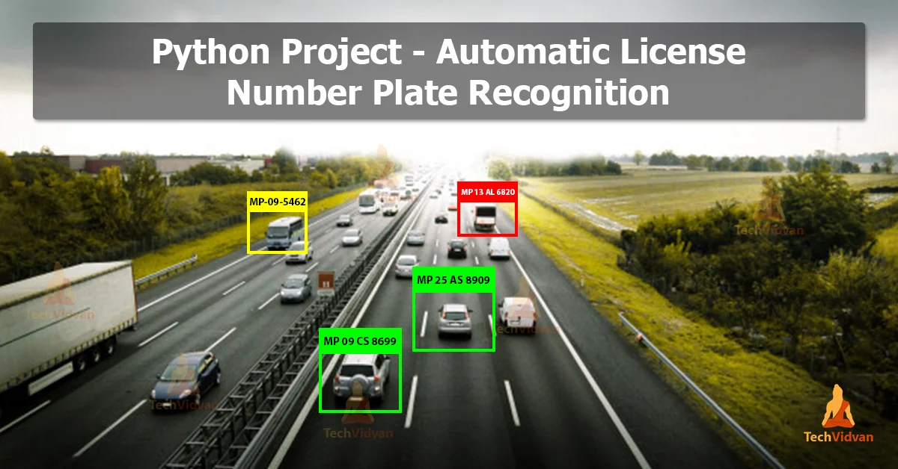
License Plate Detection and Recognition
YOLOv4 Strengths
Robustness
Ensures precise and rapid detection of license plates in complex video frames.
Handles challenges such as occlusions, varying plate sizes, and changing illumination effectively.
Scalability
Deep Learning Advantage
Easily adaptable to different regions and plate styles with proper training datasets.
Outperforms traditional edge-based or morphological methods in accuracy and reliability.

Slide 17
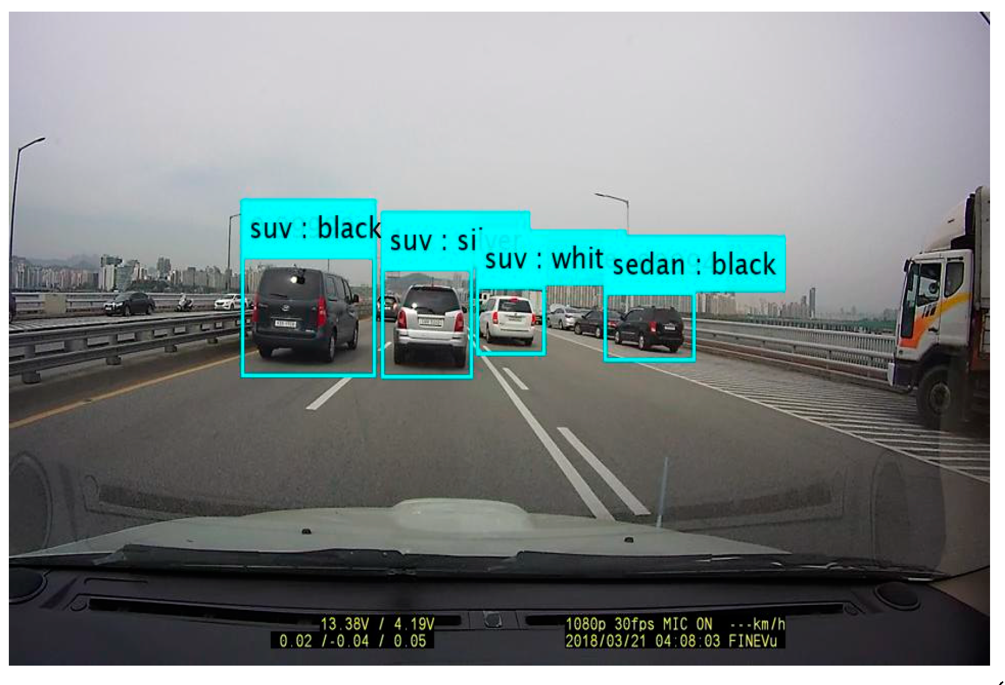
Colour Detection
Pixel-Based Method
Simplifies computation by analyzing RGB values of vehicle surfaces.
Accuracy is affected by lighting, shadows, and reflections in video frames.
Environmental Sensitivity
Efficiency
Lightweight and quick compared to more complex color detection algorithms.
Advanced processing techniques (e.g., color constancy algorithms) can enhance reliability.
Improvement Potential

Slide 18
Vehicle Logo Detection
Logo Identification with YOLOv4
Complex Background Handling
Accurately detects logos despite variations in size, angle, and partial occlusion.
Deep learning-based methods are more resilient than template matching approaches.
Manufacturer Recognition
Versatility
Works across a range of vehicle types and models with sufficient training.
Enables vehicle brand identification, adding value to traffic analysis systems.

Slide 19
Proposed Methodology
Video Frame Extraction
The input video is processed to extract individual frames for analysis.
Vehicle Detection
YOLOv4 identifies and tracks vehicles in the video frames, providing bounding boxes for each detected.
Each frame in the video is considered as an image to train in YOLO
It divides the image into an nxn grid.
It predicts bounding boxes which show the x,y coordinates (which fall on center of the grid box), and its height and width (w.r.t whole image).
Each grid then decides the confidence score, whether the object is in the box or not.
It uses a logistic function to predict bounding boxes, class prob.
Non max suppression is used to avoid multiple detections of same object .

Slide 20
Tracking Across Frames​: A Haarcascade Classifier tracks the detected vehicles across consecutive frames.​
The speed is Calculated using the Formula:​
Speed = Distance Travelled/Time Taken​
The distance is derived by measuring the displacement of the vehicle’s bounding box​
mapped to real-world coordinates​

Slide 21
04
Mathematics Application

Slide 22
Convolutional Neural Networks (CNNs):
YOLOv4 uses CNNs to scan images and extract important features like shapes, colors, and textures. It applies filters (kernels) to detect patterns in images, just like how humans recognize objects.
Bounding Box Prediction:
It predicts the position of objects using coordinates (x, y, width, height).
It refines the prediction by adjusting the box size and location.
Object Confidence Score:
YOLOv4 assigns a confidence score to determine if an object is present. If the confidence is high, it confirms the presence of an object.

Slide 23
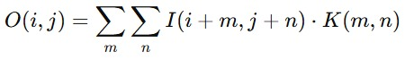
CONVOLUTION NEURAL NETWORKS
What is convolution??
Convolution is a mathematical operation that combines two functions (or signals) to produce a third function. It represents how one function modifies or interacts with another.
Convolution neural plays a prominent role in extracting features of objects and object identification.
The given input image is converted into pixels in to RGB and convolution is performed using kernels and then we extract the features.
1D –convolution------It only works on signal processing.
2D-convolution ------

Slide 24
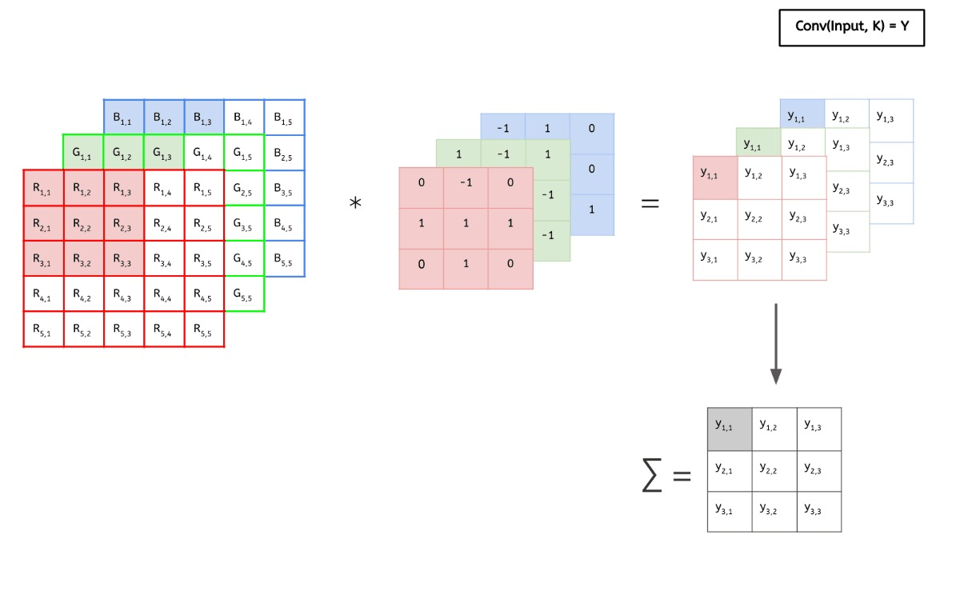
Kernels
Input image

Slide 25
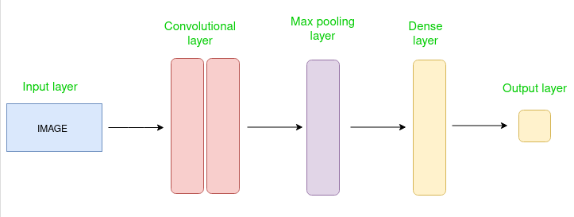

Slide 26
Conclusion
The combination of these three technologies enhances the efficiency of intelligent transportation system,
Security system, and industrial automation.
Continuous advancements in AI and machine learning are expected to further improve accuracy and processing

Slide 27
THANKS!

